Slide 1
Objects
10 minute oyster

Slide 2
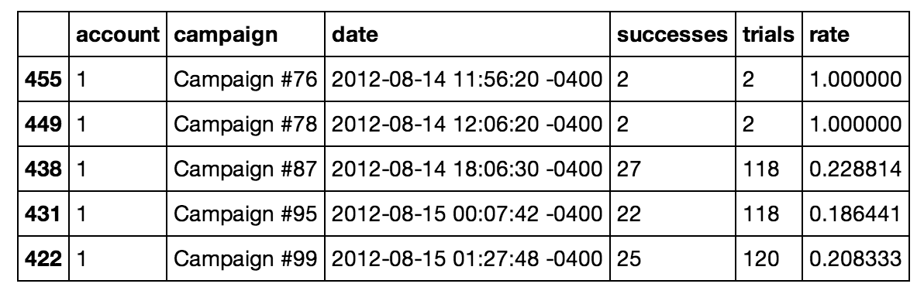
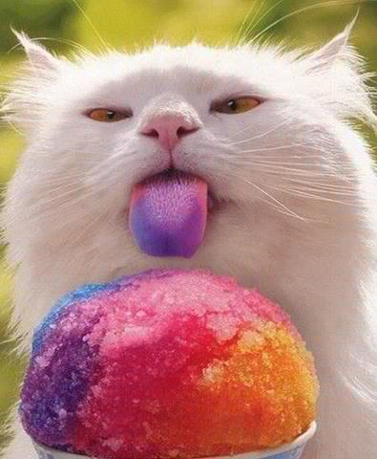
Objects
What happens when we type 7 into the python prompt? Or “text”?
7 and “text” are examples of Python objects.
Object sounds like a rather general term – and it is. An object is basically a container for data.
When you type in 7, Python creates an object to store the data in 7 (just a little data)
Why is this important?
At a low level, all data is stored as a bunch of zeros and ones in memory
The data for 7 has to be kept separate from the data for Bill,
Our customer records must be kept separate from our company logo, etc…
Objects ensure that we keep these things separate.
Here’s a depiction of an object space – all the objects you can access.
You can see several types of data, all kept separate.
You can think of objects as containers that can hold any type of data.
Surprisingly, even the code you write is held in objects.
Object Space
in Memory
1.5
print(“Hello world!”)
Sales in the third quarter were higher than expected…

Slide 3
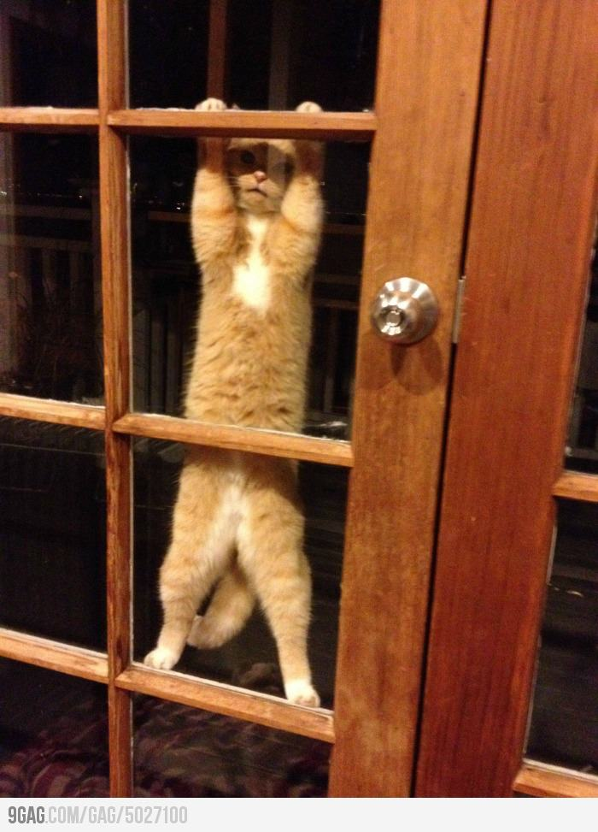
Types
Object Space
36
7
int
int
print(“Hello world!”)
function
file
You can think about a program as instructions to manipulate objects
In computer memory, all objects are stored as zeros and ones.
You wouldn’t be able to look at the 0’s and 1’s and tell a table of customer data apart from a photo.
But of course, the types of things you can do to a data table are very different than those you can do to a photo.
For this reason, we need to keep track of what type of data is in each object.
To do this, each object in Python has a type.
We can call it a type or a class – these are essentially interchangable in Python 3.
In this object space, you can see that 36 is of type int – so we know it holds an integer. The print line is of type function, so we know that it’s something we can run.

Slide 4
Python is strongly-typed: That means that it will restrict the operations you can perform, based on an object’s type.
You can add two integers together, but not two functions.
This makes it safer to program in. It keeps you from making some mistakes.
In a weakly-typed language, the computer will let you do things like add functions together – but the result probably won’t make any sense and it may be hard for you to figure out why your functions don’t work.

Slide 5
Representing Numbers
To program effectively, you’ll need to know what types of objects can hold your data and how they behave.
For example, one of the first things you’ll need to do is store numbers.
In python, there’s two main ways to do this, and it depends on what type of numbers you’re dealing with.
First, if you’re working with whole numbers
Say you need to record the number of visits to your website, or how many cats a survey respondent has.
You can use an integer – an object of type int.
You can store 0, 1, 2, 3… (and negative ones, -1, -2, -3…)
Interestingly, there’s no limit to how large the integer can be. If you make an integer larger and larger, the python interpreter will allocate more and more memory to store it.
Eventually, your computer will run out of memory, so that’s really the limit- but that’s a pretty remote possibility.

Slide 6
Representing Numbers
What if you need to record a number that’s not an integer
Say the fraction of jellybeans that’s red, or ½, or π.
You can use a type of object called a float (short for floating point)
This is an approximation for real numbers
You can’t store most real numbers exactly, because a real number may not terminate
It can have an infinite number of digits after the decimal point.
Think about π, it’s 3.1415925635… and the digits go on.
So python has to stop recording the digits after a while – and it does so after about 16 decimal places.
Everything after that gets chopped off – this is called rounding error.
And you can get rounding error when you don’t expect it, because python stores floats in base 2.
A computer is binary, so everything has to be stored as zero’s and one’s.
In base 2, a number is written in just zero’s and one’s as well.
1.1 looks nice in base 10, but does not terminate in base 2: 1.00011001100110011001100110011….
So you get rounding error when you store 1.1 as a float.
This type of rounding error is very small, but there are some situations where it can be important. Be careful if you’re expecting floats to be exactly equal.

Slide 7
Variables

Slide 8
We’ve seen that data is held in containers called objects.
We need a way to identify which object we want to access.
One solution would be to use the memory location for the object
But memory locations are large complicated numbers that may be different from computer to computer.
Instead, we use a system of variables – these are the names we use to access objects.
So when we type x = 5, we create a new variable, x, which becomes a name for the object, 5.

Slide 9
Variables
Name Space
Object Space
x
5
b_int
36
int
int
c_int
print(“Hello world!”)
greet
function
file
Here’s a picture of what’s happening.
Variables go into a special object called a name space.
When we write x = 5, we create a new name, x, and bind it to the object, 5.
An object needs at least one name to be accessed.
If we lose all names that point to an object, it’s lost forever (the interpreter will garbage collect it so the memory can be reused)
Names don’t have types – Python is dynamically typed
This means that x can refer to an int at one time, but maybe a function at a later time.
This gives us a lot of freedom.
It also means that we can make mistakes, thinking we have one type of object when we have another.
A good idea is to include the type of object you’re expecting at the end of your variable name, so you know what type to expect.

